Slide 1
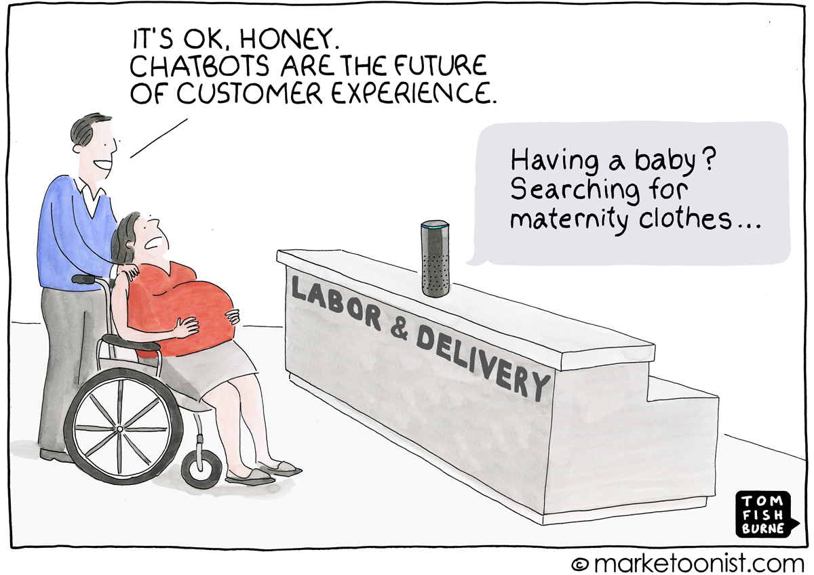
Usability of AI tools
Rohan Shrestha
Notes:
- brief background of AI-based tools
- how AI is changing the way we interact with technology
- as human factors professionals, how we can make AI tools more human friendly

Slide 2


Shifting paradigm of interaction
🤖
Batch Processing
Command-based Interaction
Intent-based Outcome Specification
1945 – 1960s
Need to specify every step of a task
Single output
1964 – 2023
Command line, terminals, GUI
Turn-based command
Dynamic goal modification
2023 –
AI-based
Explain the desired outcome; minimal or no instructions on how to get it
Notes:
Third paradigm is more relevant with LLM and generative AI.
Future: hybrid with assistance from the AI tools and making controls available to humans

Slide 3
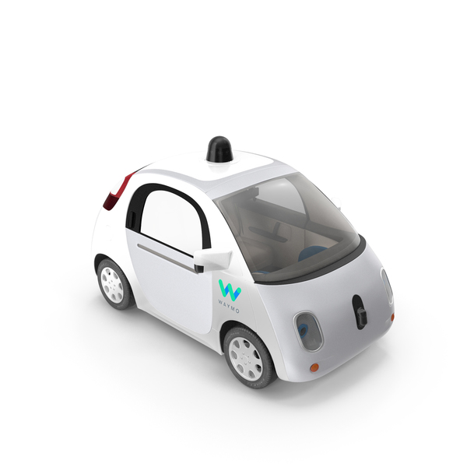
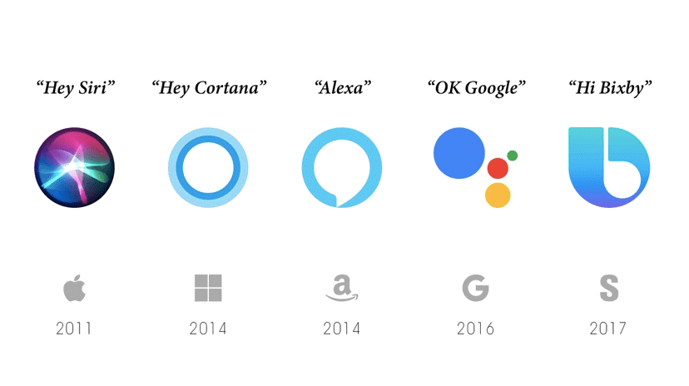
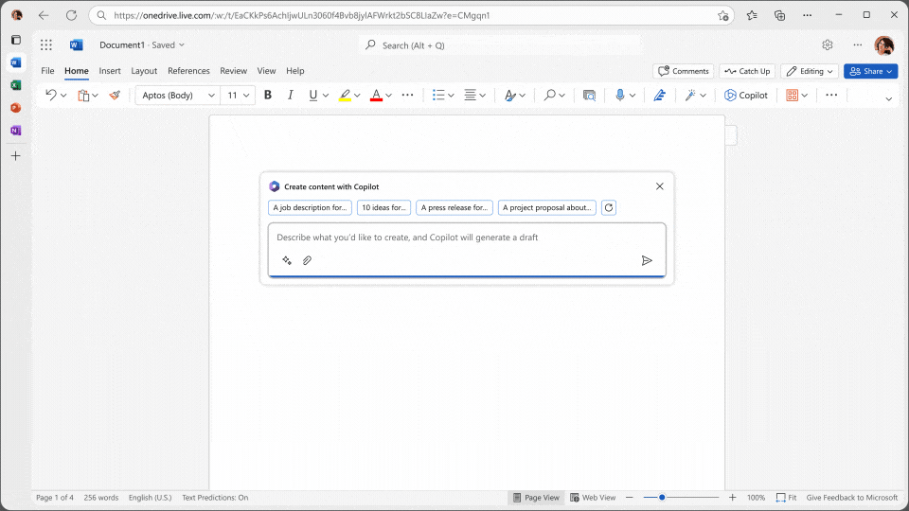
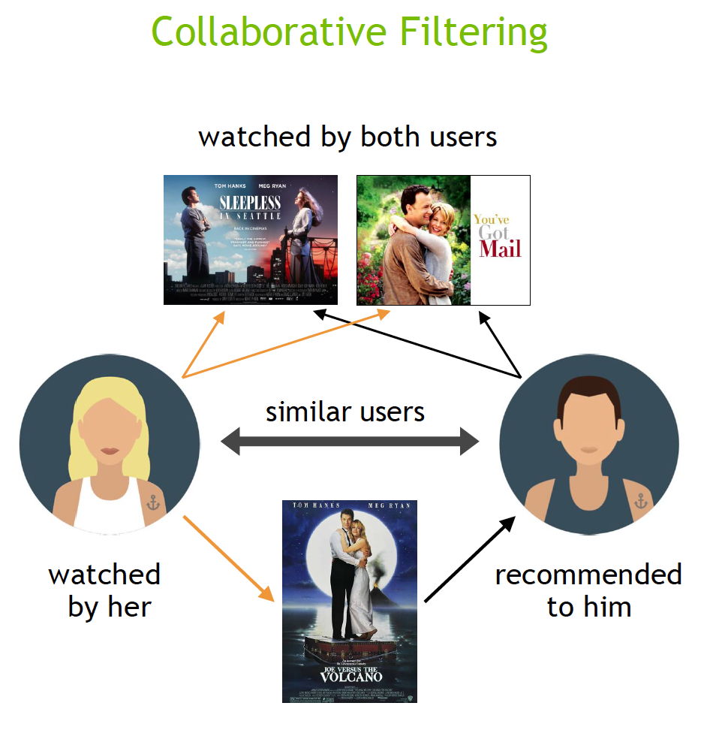

AI everywhere
Notes:
- any tool that incorporates AI techniques like machine learning, natural language processing, computer vision to exhibit intelligent behavior, learn from data, adapt to different situations
- decision making, doing complex tasks, automation, learning from data

Slide 4
Types of AI driven applications
AI assistants
General: Siri, Google Assistant, Alexa
Task-specific: SciSpace for research, Github Copilot for developers
Chatbots: ChatGPT, Bing/Copilot
Generator tools: DallE (Images), Jasper (writing, marketing), Runway (video), etc.)

Slide 5

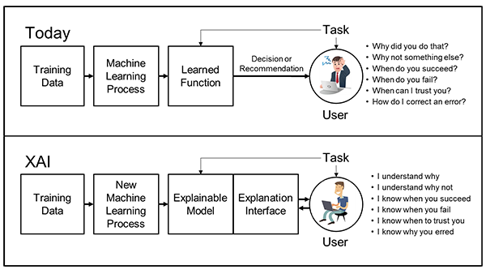
Explainable AI
Image source: DARPA
Notes:
To make AI algorithms more transparent to allow users to understand and trust the results produces by machine learning algorithms
Extracting explanations: Developing techniques to extract explanations from black-box AI models.
Presenting explanations: How to present explanations to users, such as through the explanation user interface.

Slide 6
Guidelines for Human-AI interaction
18 general design guidelines for human-AI interaction
Based on the synthesis of over 150 AI-related design recommendations from academic and industry sources over the last 20 years
Notes:
1) Are the guidelines relevant? That is, can we identify examples of each guideline across a variety of products and features? 2) Are the guidelines clear? That is, can participants understand and diferentiate among them?

Slide 7
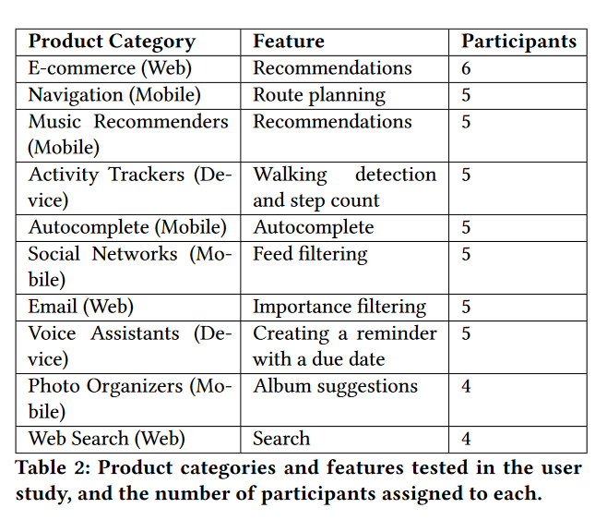
Tested Applications
Validated through multiple rounds of evaluation
User study with 49 design practitioners
Tested with 20 popular AI-infused products spanning categories like e-commerce, voice assistants, recommendation systems, etc.

Slide 8
 |  | Guidelines
Before Interaction | 1 | Make clear what the system can do.
 | 2 | Make clear how well the system can do what it can.
During Interaction | 3 | Time services based on context.
 | 4 | Show contextually relevant information.
 | 5 | Match relevant social norms.
 | 6 | Mitigate social biases.
When things go wrong | 7 | Support efficient invocation.
 | 8 | Support efficient dismissal.
 | 9 | Support efficient correction.
 | 10 | Scope services when in doubt.
 | 11 | Make clear why the system did what it did.
Over time | 12 | Remember recent interactions.
 | 13 | Learn from user behavior.
 | 14 | Update and adapt cautiously.
 | 15 | Encourage granular feedback.
 | 16 | Convey the consequences of user actions.
 | 17 | Provide global controls.
 | 18 | Notify users about changes.

Slide 9
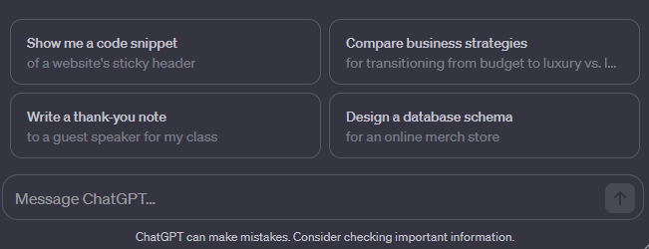
Before interaction
Make clear what the system can do
Help the user understand what the AI system is capable of doing.
Make clear how well the system can do what it can do
Help the user understand how often the AI system may make mistakes.

Slide 10
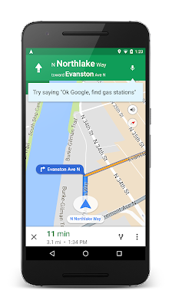
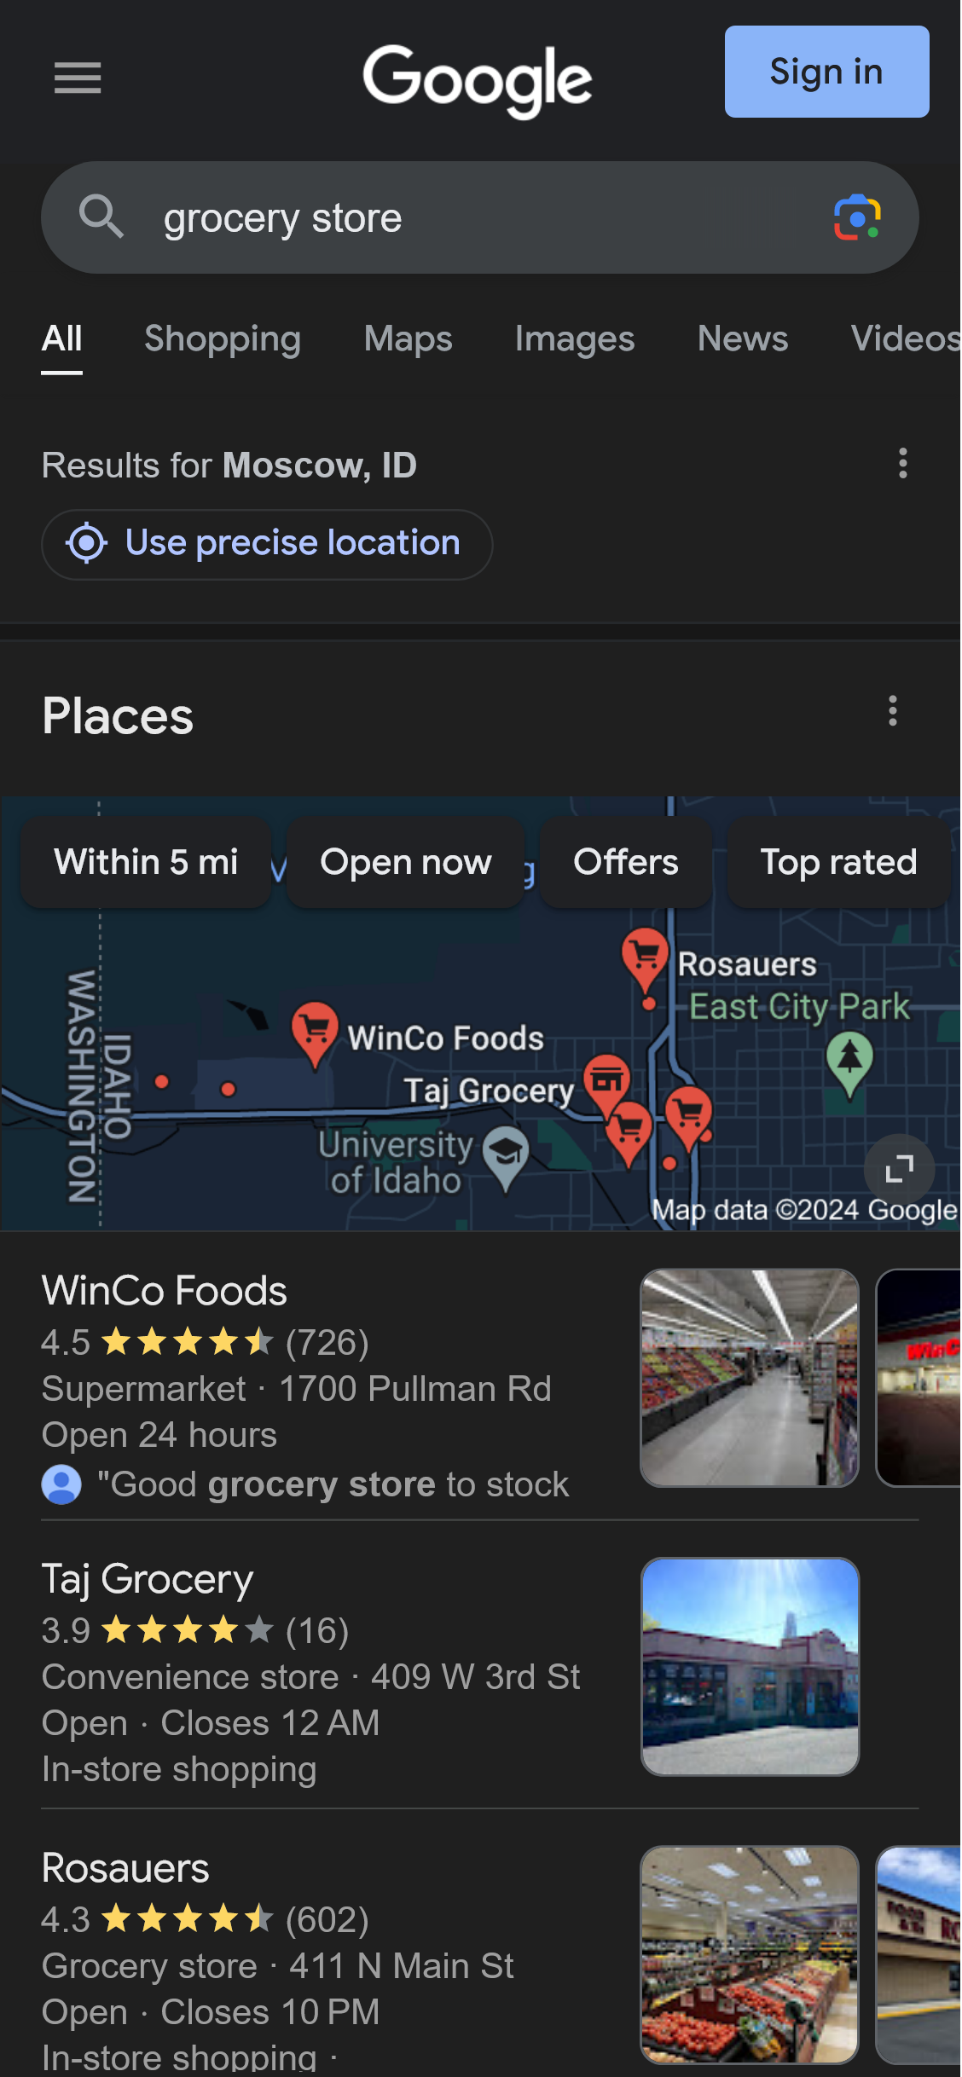
During interaction
Time services based on context.
Time when to act or interrupt based on the user’s current task and environment.
Show contextually relevant information.
Display information relevant to the user’s current task and environment.

Slide 11


During interaction (contd.)
Match relevant social norms.
Ensure the experience is delivered in a way that users would expect, given their social and cultural context.
Mitigate social biases.
Ensure the AI system’s language and behaviors do not reinforce undesirable and unfair stereotypes and biases.

Slide 12

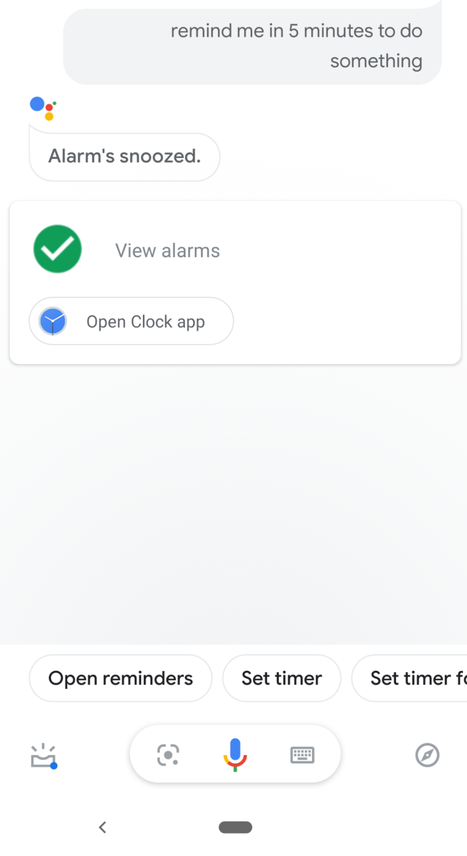
When things go wrong
“Hey Google”, “Hey Siri”
Support efficient invocation
Make it easy to invoke or request the AI system’s services when needed.
Support efficient dismissal.
Make it easy to dismiss or ignore undesired AI system services.
Support efficient correction.
Make it easy to edit, refine, or recover when the AI system is wrong.

Slide 13

When things go wrong (contd.)
Scope services when in doubt
Engage in disambiguation or gracefully degrade the AI system’s services when uncertain about a user’s goals.
Make clear why the system did what it did.
Enable the user to access an explanation of why the AI system behaved as it did.

Slide 14

Over time
Remember recent interactions.
Maintain short term memory and allow the user to make efficient references to that memory.
Learn from user behavior.
Personalize the user’s experience by learning from their actions over time.
Update and adapt cautiously.
Limit disruptive changes when updating and adapting the AI system’s behaviors.
Encourage granular feedback.
Enable the user to provide feedback indicating their preferences during regular interaction with the AI system.
Notes:
Update and adapt: explain how spotify recommends songs similar to the ones you are listening to next but you can go back to the previous song without dramatically changing the recommendations

Slide 15


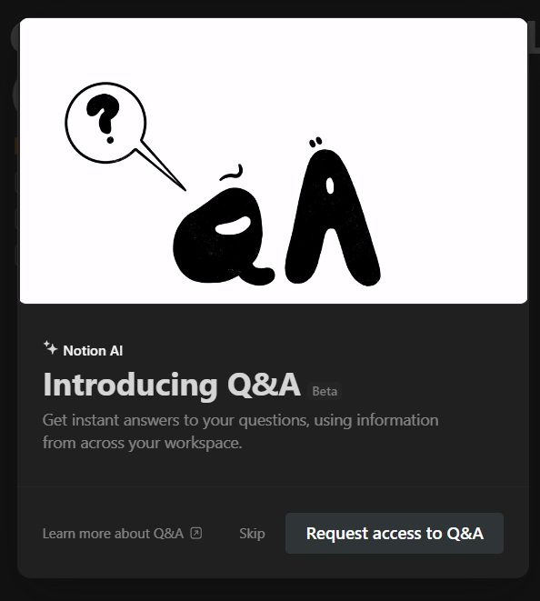
Over time (contd.)
Convey the consequences of user actions.
Immediately update or convey how user actions will impact future behaviors of the AI system.
Provide global controls.
Allow the user to globally customize what the AI system monitors and how it behaves.
Notify users about changes.
Inform the user when the AI system adds or updates its capabilities.

Slide 16
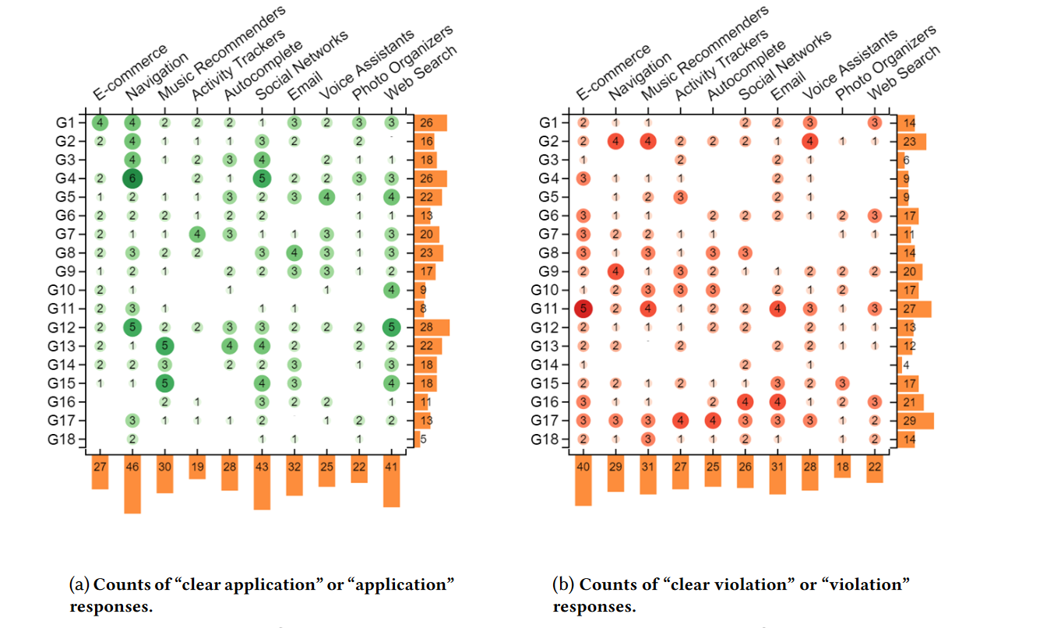
Application of the guidelines

Slide 17
References
Amershi, Saleema, Dan Weld, Mihaela Vorvoreanu, Adam Fourney, Besmira Nushi, Penny Collisson, Jina Suh, et al. “Guidelines for Human-AI Interaction.” In Proceedings of the 2019 CHI Conference on Human Factors in Computing Systems, 1–13. CHI ’19. New York, NY, USA: Association for Computing Machinery, 2019. https://doi.org/10.1145/3290605.3300233.
Experience, World Leaders in Research-Based User. “AI: First New UI Paradigm in 60 Years.” Nielsen Norman Group. Accessed January 23, 2024. https://www.nngroup.com/articles/ai-paradigm/.
Nielsen, Jakob. “AI Is First New UI Paradigm in 60 Years.” Substack newsletter. Jakob Nielsen on UX (blog), June 22, 2023. https://jakobnielsenphd.substack.com/p/ai-is-first-new-ui-paradigm-in-60.

